Slide 1







Slide 2
Housing Tax Credit Basics
For Developers

Slide 3

AGENDA
Overview of the LIHTC Program
  History
  Definitions
General LIHTC Structure
  Types of LIHTCs
  Tax Credit Calculation
  Program Players
    Example LIHTC Deal
LIHTC Timeline
Program Rules
  Compliance
  Avoiding Recapture

Slide 4






Pre-Tax Reform Act of 1986
Building Affordable Housing…
  Taxpayers would pay Uncle Sam
  Uncle Sam would build housing
  Housing would rent to low-income tenants
  RD/HUD – Provide Rental Assistance
  Housing inventory deteriorates
  Financial Structure

Slide 5






Tax Reform Act of 1986
Low-Income Housing Tax Credit Program…
  Awards developers federal tax credits;
  which are used to offset construction costs;
  in exchange for reserving a fraction of units for lower-income households.
  Tax credits claimed annually for 10 years
  Developers sell the credits to investors in exchange for equity financing.
  Equity reduces the debt needed, which allows more affordable rents
  Financial Structure!

Slide 6
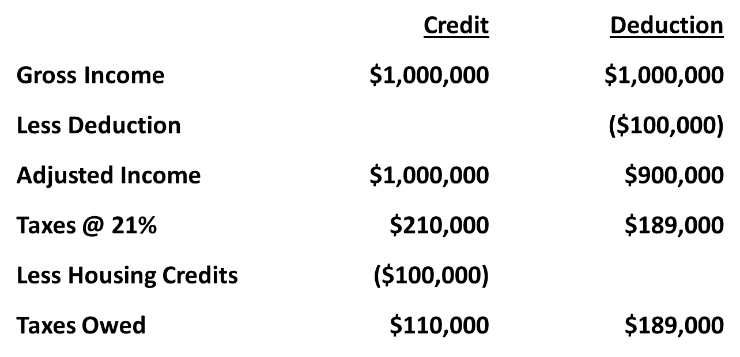
Definitions
Tax Credit
  A dollar-for-dollar deduction against the tax liability of an individual or corporation

Slide 7
Definitions
Eligible Basis (How much it costs?)
  Development costs minus – land, building acquisition costs, syndication, organization, or permanent financing cost.
    Includes soft costs that exist because of the development
      Architectural fees
      Engineering fees
      Developer fees
Basis Boost – Depending on location, eligible basis can be increased by 30%
    Difficult Development Area (DDA)
    Qualified Census Tract (QCT)
Applicable Fraction - Percentage of the building that is treated as low-income use and eligible for the LIHTC (use the lesser of the unit fraction or the floor space fraction).

Slide 8
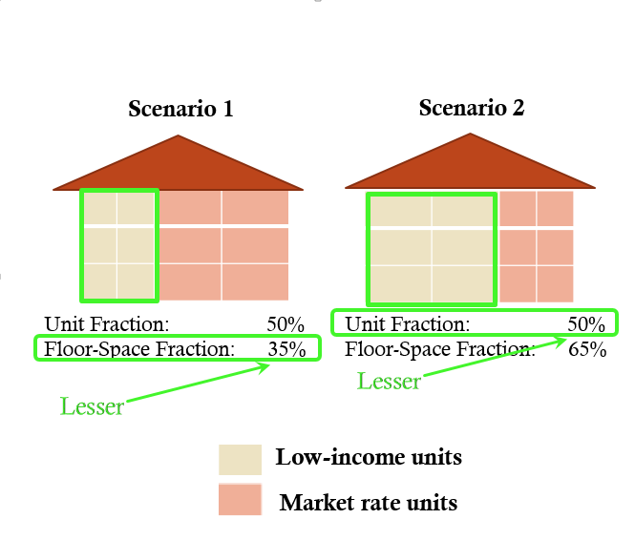
Definitions
Applicable Fraction - % of units or square footage set aside for LI use

Slide 9
Definitions
Qualified Basis (How much of what was spent went towards low-income use?)
  Eligible Basis multiplied by the applicable fraction
    EB x BB (if appliable) x AF = QB
10 LI Units / 10 Total Units
Costs: $4,000,000
DDA? Yes
QCT? No
EB: $4,000,000
BB: 30%
Adj EB $5,200,000
AF: 100%
QB: $5,200,000
8 LI Units / 10 Total Units
Costs: $3,000,000
DDA? No
QCT? No
EB: $3,000,000
BB: -----
AF: 80%
QB: $2,400,000

Slide 10
Types of LIHTC
Housing Tax Credit Basics For Developers

Slide 11
Types of LIHTC
9% Credits
  Competitive Credit
  Annual LIHTC allocation authority
  New Construction & Rehabilitation
  70% present value

Slide 12
Types of LIHTC
4% Credits
  Non-Competitive Credit
  Automatic award if coupled w/Tax Exempt Bonds
  Acquisition & Rehabilitation
  Not drawn from the annual LIHTC Authority
  30% present value

Slide 13
Tax Credit Calculations
Computing 9% Tax Credits
10 LI Units / 10 Total Units
Costs: $4,000,000
DDA? Yes
QCT? No
Eligible Basis $4,000,000
Basis Boost 30%
Adj Eligible Basis $5,200,000
Applicable Fraction 100%
Qualified Basis: $5,200,000
Tax Credit Rate: 9%
Annual Tax Credits $468,000
X 10 Years
Total Tax Credits $4,680,000
8 LI Units / 10 Total Units
Costs: $3,000,000
DDA? No
QCT? No
Eligible Basis: $3,000,000
Basis Boost: -----
Applicable Fraction: 80%
Qualified Basis: $2,400,000
Tax Credit Rate 9%
Annual Tax Credits $216,000
x 10 Years
Total Tax Credits $2,160,000

Slide 14
Tax Credit Calculations
Computing 4% Tax Credits
12 LI Units / 12 Total Units
Costs: $5,000,000
DDA? Yes
QCT? No
Eligible Basis $5,000,000
Basis Boost: 30%
Adj Eligible Basis: $6,500,000
Applicable Fraction: 100%
Qualified Basis: $6,500,000
Tax Credit Rate 4%
Annual Tax Credits $260,000
x 10 Years
Total Tax Credits $2,600,000
12 LI Units / 15 Total Units
Costs: $7,000,000
DDA? Yes
QCT? No
Eligible Basis $7,000,000
Basis Boost 30%
Adj Eligible Basis $9,100,000
Applicable Fraction 80%
Qualified Basis: $7,280,000
Tax Credit Rate: 4%
Annual Tax Credits $291,200
x 10 Years
Total Tax Credits $2,912,000

Slide 15
Program Players
Housing Tax Credit Basics For Developers

Slide 16

Internal Revenue Service
Oversees implementation of the program
Allocates LIHTCs to each state according to its population
  2025 LIHTC Per Capita: $3/person
  Mississippi population: 2,939,690
  2025 MS Credit Authority: $8,819,070
Recapture Credits due to noncompliance

Slide 17

State Housing Finance Agency
Administers the LIHTC Program
Develop a Qualified Allocation Plan (QAP)
Awards LIHTCs to developers based on their QAP
  Required to give priority to:
    Lowest-income households
    Longest affordability period
    Special Target populations
Perform Compliance Monitoring duties

Slide 18

Developers/
Owners
“General Partner”
Responsible for overseeing the development of the Project
Oversee the rent-up
Responsible for credit delivery (compliance)
Benefit of Developers
  Fees:
    Developer Fee
    Management Fee (is applicable)
    Incentive Leasing Fee
Potential for cash flow

Slide 19
Investors
Equity providers
“Limited Partner”
Satisfies local area housing needs
Satisfies Community Reinvestment Act (CRA) Requirements
  Prevents discrimination against low or moderate income neighborhoods
  Financial institutions not in compliance with the CRA can have their applications for future mergers denied.
Fees
  Asset management Fee
Potential for cash flow

Slide 20
Lenders
Construction Financing
Permanent Financing
  MHC requires 10% permanent debt
Loan Fees
Interest Income
Meets CRA requirements

Slide 21
Contractors
Ensure timely completion of constuction
  50% Completion (15-months)
  Place In Service Deadline (12/31 of 2nd year)
Profits – 6%
Overhead – 2%
General Requirements - 6%

Slide 22
Other Players
Syndicators
  Help bridge the gap between various parties to affordable housing transactions
  Works with both the General Partner (developer) and the Limited Partner (investor)
  Collects a fee for overseeing the investment transaction
CPAs
  Projections / Budgets
  10% Test Certifications
  Cost Certifications
  Annual Audits and Tax Returns

Slide 23
Partnership Agreement
Establishes Roles of each member of the partnership
  Developer: deliver credits
  Investor: invest capital
  Syndicator: Asset management
Establishes Credit Pricing
  How much per tax credit dollar
    Average: $0.87
Timeline for Capital Installments (Equity payments)
  50% Completion
  Place In Service
  Lease-Up
  Issuance of IRS Form 8609
Penalties
  Noncompliance

Slide 24
Tax Credit Calculations
Computing Equity
10 LI Units / 10 Total Units
Costs: $3,000,000
DDA? No
QCT? No
Eligible Basis: $3,000,000
Basis Boost: -----
Applicable Fraction: 100%
Qualified Basis: $3,000,000
Tax Credit Rate 9%
Annual Tax Credits $270,000
x 10 Years
Total Tax Credits $2,700,000
Price per $ $0.87
TC Equity $2,349,000
8 LI Units / 10 Total Units
Costs: $4,000,000
DDA? Yes
QCT? No
Eligible Basis $4,000,000
Basis Boost 30%
Adj Eligible Basis $5,200,000
Applicable Fraction 80%
Qualified Basis: $4,160,000
Tax Credit Rate: 9%
Annual Tax Credits $374,400
X 10 Years
Total Tax Credits $3,744,000
Price per $ $0.83
TC Equity $3,107,520

Slide 25
Tax Credit Calculations
Financial Structure
10 LI Units / 10 Total Units
Costs: $3,000,000
LIHTC Equity $2,349,000
Remaining Debt $651,000
8 LI Units / 10 Total Units
Costs: $4,000,000
LIHTC Equity $3,107,520
Remaining Debt $892,480

Slide 26
Annual Credit Calculation (9%)
Total Development Budget $7,815,048
Ineligible costs (680,711)
Applicable Fraction 100%
QCT/DDA Basis Boost 0%
Applicable Rate 9%
Annual Reserved Tax Credits $642,090

Slide 27
Tax Credit Equity Calculation (9%)
Annual Tax Credits $642,090
Credit Period x 10
Total Tax Credits $6,420,900
Price paid x $0.87
Equity $5,586,183
Equity represents 71.4% of development costs

Slide 28
Annual Credit Calculation (4%)
Total Development Budget $7,815,048
Less ineligible costs (645,146)
Eligible Basis $7,169,902
Applicable Fraction 100%
QCT/DDA Basis Boost + 30%
Qualified Basis $9,320,873
Credit Rate 4.00%
Annual Tax Credits $372,835

Slide 29
Tax Credit Equity Calculation (4%)
Annual Tax Credits $372,835
Credit Period x 10
Total Tax Credits $3,728,350
Price paid x $0.85
Equity $3,169,098
Equity represents approximately 40% of development costs

Slide 30










Tax Credit Timeline
Place in Service
*50% Completion
Maintain Compliance
120 Days
LIHTC Reservation
Lease-Up w/ Qualified Tenants
10% Test
Apply for LIHTCs
Request/Receive IRS Form 8609
Carryover Agreement

Slide 31
Program Rules
Unit Restrictions
  Don’t rent LIHTC units to people who make too much money
  Don’t charge low-income families too much rent
  Families must earn less than 60% (or 50% depending on minimum set aside) of area median income
      Based on HUD median income data, adjusted for family size
    Threshold Elections
        20/50 minimum set aside- 20% of units must be rented to 50% AMI
        40/60 minimum set aside- 40% of units must be rented to 60% AMI
        Average Income Election
  Rent Restricted – How much can tenants pay?
      Rents and utilities – limited to 30% of threshold income
      Allowable rent based on size of unit
  Program requires a 15-year compliance period but can be extended to increase chances of getting awarded.

Slide 32
Program Rules
Income Restrictions: Minimum Set-Aside
At least 40% of the property must be set aside for families earning below 60% of the Area Median Income.
-OR-
At least 20% of the property must be set aside for families earning below 50% of the Area Median Income.
-OR-
Average Income

Slide 33
Compliance
Compliance period for developments is 15 years
An extended use agreement is required. This extends the period for which the project must remain low-income housing – usually adding 15 to 35 years; known as “LURA” (land use restriction agreement). Foreclosure terminates this agreement. If the owner is unable to continue, the state agency must find a buyer with a “Qualified Contract” to maintain the restricted rents and tenant certification. If one cannot be provided, the project remains restricted for 3 years.

Slide 34
Compliance
State annual compliance
Owner annual compliance certifications
Owner recordkeeping requirements
Noncompliance
Form 8823
Ramifications of non-compliance - Recapture

Slide 35
TAX CREDITS DEPARTMENT
Cliff Homes
Senior VP of Tax Credits
Cliff.Holmes@mshc.com
Brandon Morey
VP of Tax Credits
Brandon.Morey@mshc.com
Victoria Mayberry
Tax Credit Analyst
Victoria.Mayberry@mshc.com

